Slide 1
OmniControl Intelligent Desktop Mode Assistant
Voice-Activated | Web-Enabled | AI-Powered Automation
Jutsu of Ai & Python Architect (J.A.P.A)

Slide 2


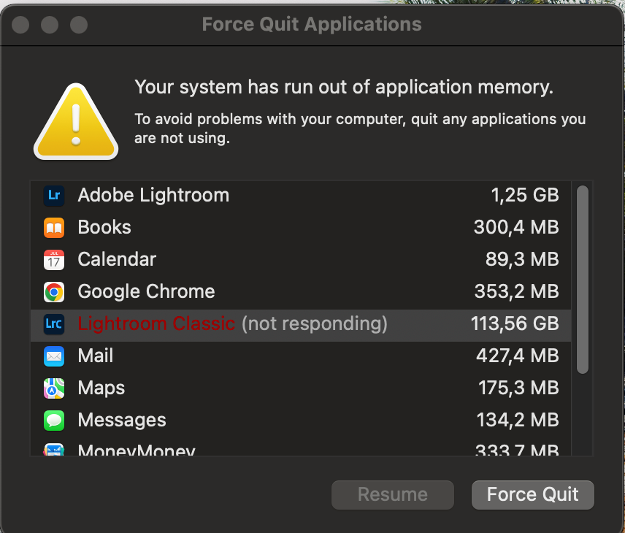
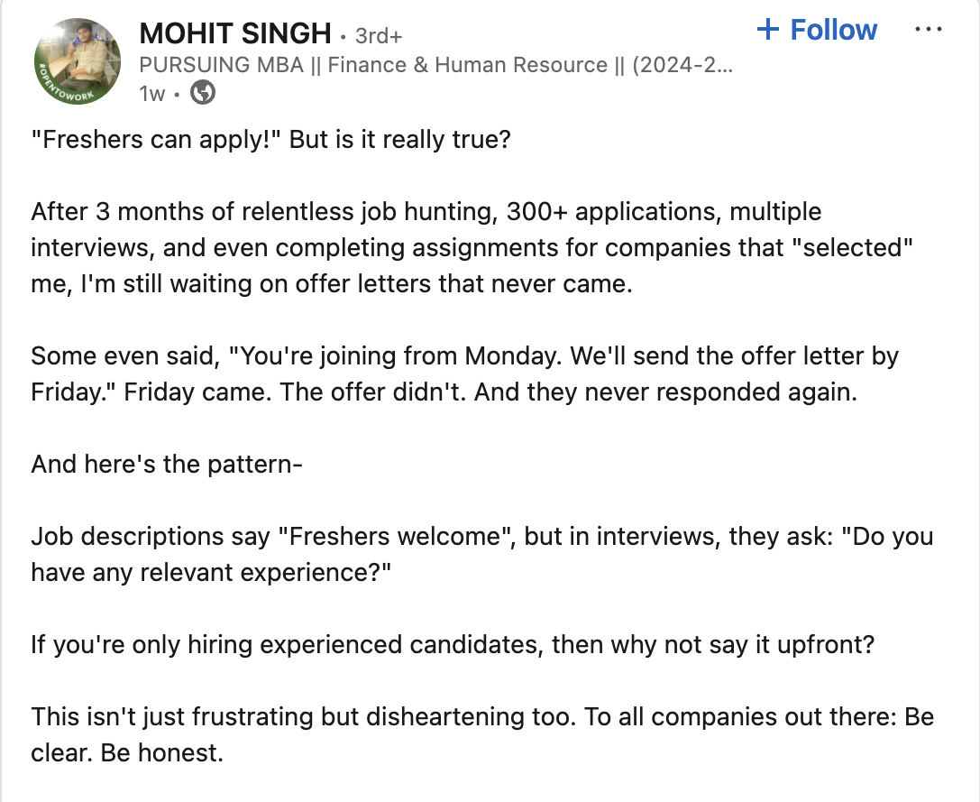
GAMERS
STUDENTS
THE NEED OF AN UNIFIED INTELLIGENT ASSISTANT
WORKERS
JOB SEEKERS

Slide 3
Problem Statement​
Modern desktop users—gamers, professionals, students—struggle with productivity when switching contexts.
Gamers must close work tools; workers need to kill distractions. Students often get sidetracked. Job seekers waste hours applying manually.
Repetitive app-switching leads to inefficiency and frustration.

Slide 4
Thought Process and Alignment
From the beginning, we aimed to solve a problem that every digital user faces: the constant need to switch contexts—between gaming, working, relaxing, and job hunting—by manually opening and closing apps. This felt repetitive, time-consuming, and inefficient.
This hackathon focused on reducing digital friction, promoting intelligent agents, and enhancing productivity through multimodal interaction. OmniControl meets these goals with its voice-based and web-based control (multimodal), dynamic app learning (intelligence), and single-click mode transitions (productivity). It adapts over time, supports multiple user types (gamers, professionals, students), and shows how an assistant can truly reduce manual effort in real-world workflows.

Slide 5
Proposed Solution
OmniControl is a Python-based assistant that:
- Switches modes via voice or web UI
- Closes or opens apps based on mode
- Learns user preferences over time
- Optimizes RAM and desktop performance
- Works for gamers, professionals, job seekers

Slide 6
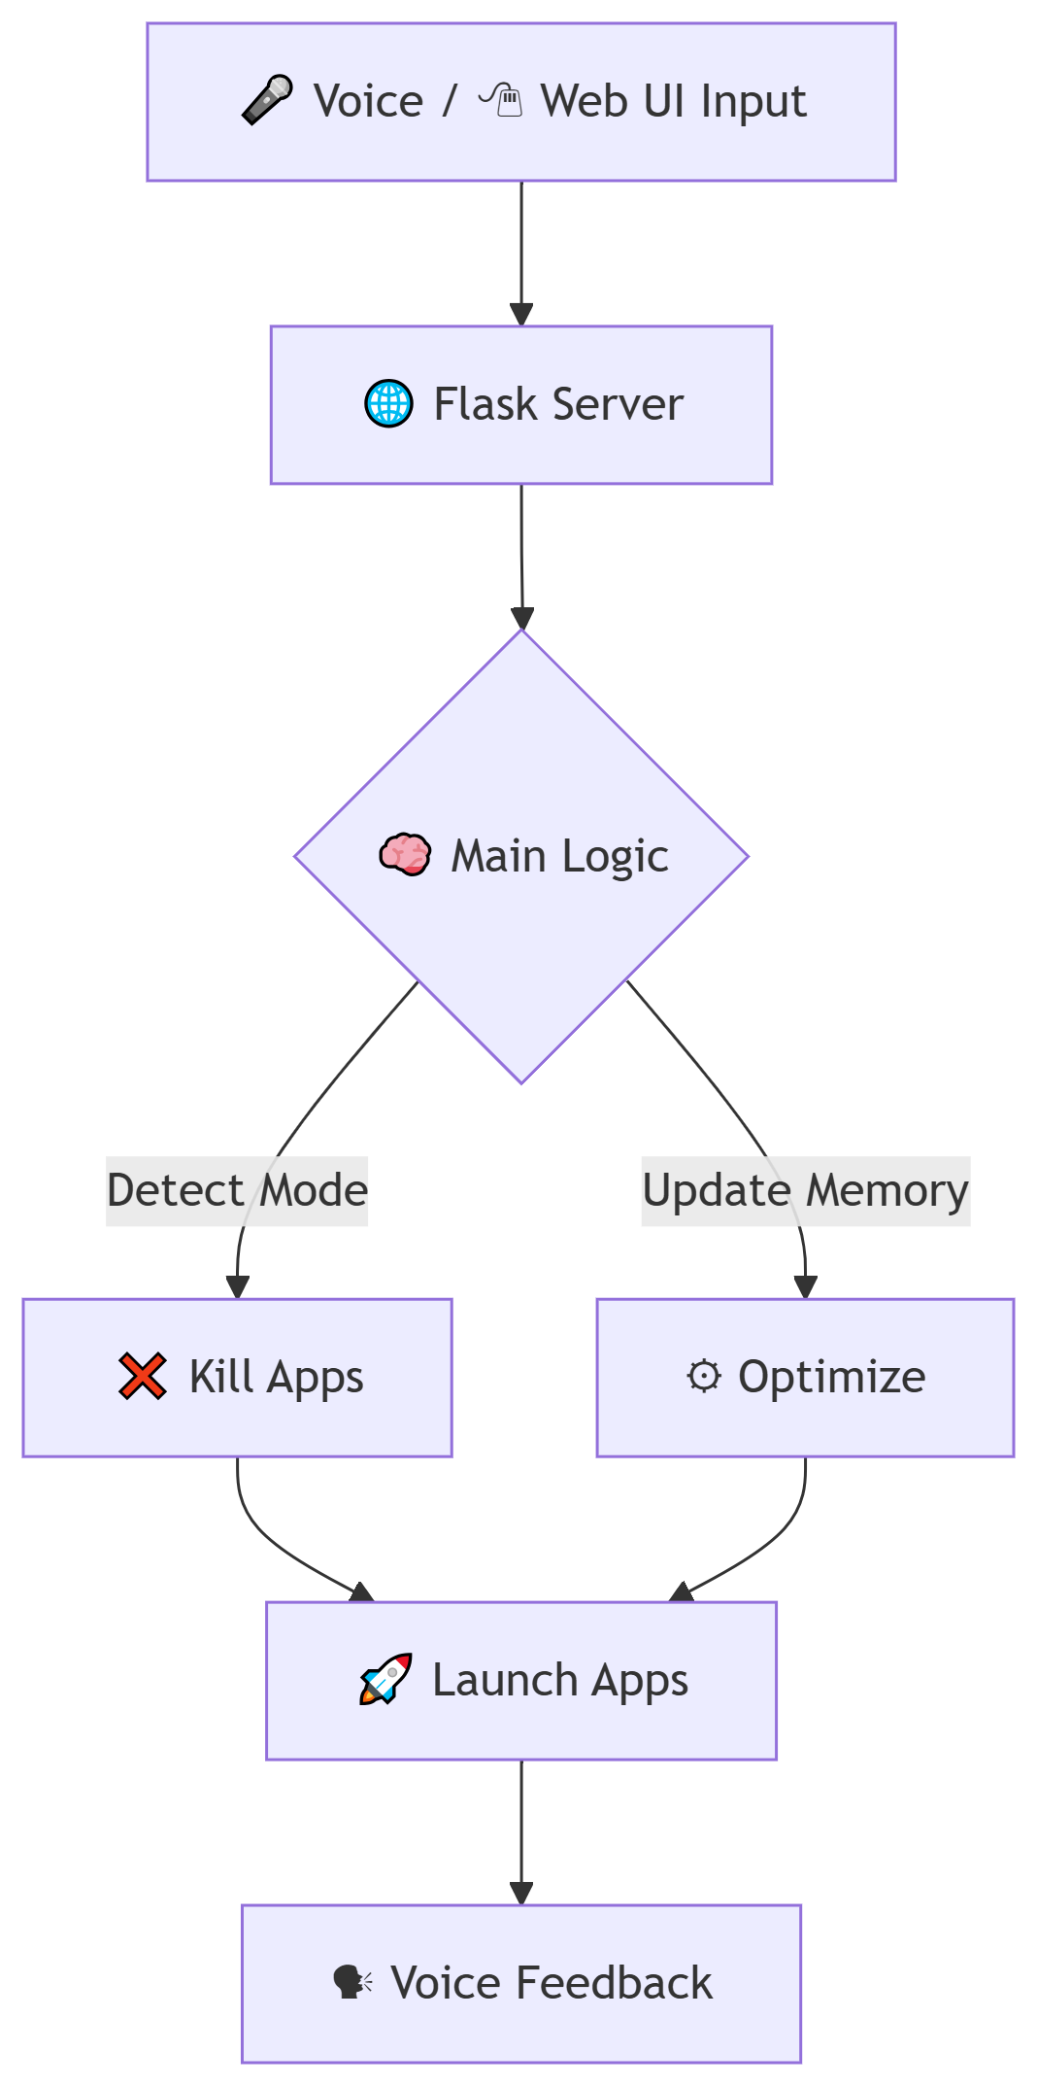
Flow of Work
🎤 Voice / 🖱Web UI Input
↓
🌐 Flask Server (Receives Mode Command)
↓
🧠 Main Logic (Detect Mode + Update Memory)
↓
❌ Kill Apps (Closes Unneeded + Learned Processes)
↓
⚙ Optimize (Simulate RAM/CPU Boost)
↓
🚀 Launch Apps (Discord, Teams, LinkedIn, etc.)
↓
🗣 Voice Feedback ("Game Mode Activated", etc.)

Slide 7
System Architecture
- Python (psutil, PyAutoGUI) for app control
- pyttsx3 + speech_recognition for voice + OpenCV for gaze detection
- Flask for web server
- HTML/CSS/JavaScript for frontend UI
- Dynamic learning via JSON memory
- Subprocess mode switching

Slide 8
Future Scope
- Job auto-apply automation
- Resume tailoring with LLMs
- Full GUI learning with VLMs
- Cross-device mode syncing
- Biometric-based smart mode switching
- 24/7 tray assistant with notifications

